Slide 1
Lesson 2: Object Recognition
Card controlled car (part 1)

Slide 2
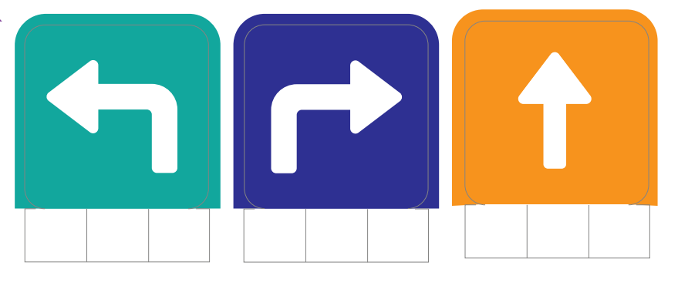
Requirements
A computer with webcam
A PictoBlox account
A printout of the require cards

Slide 3
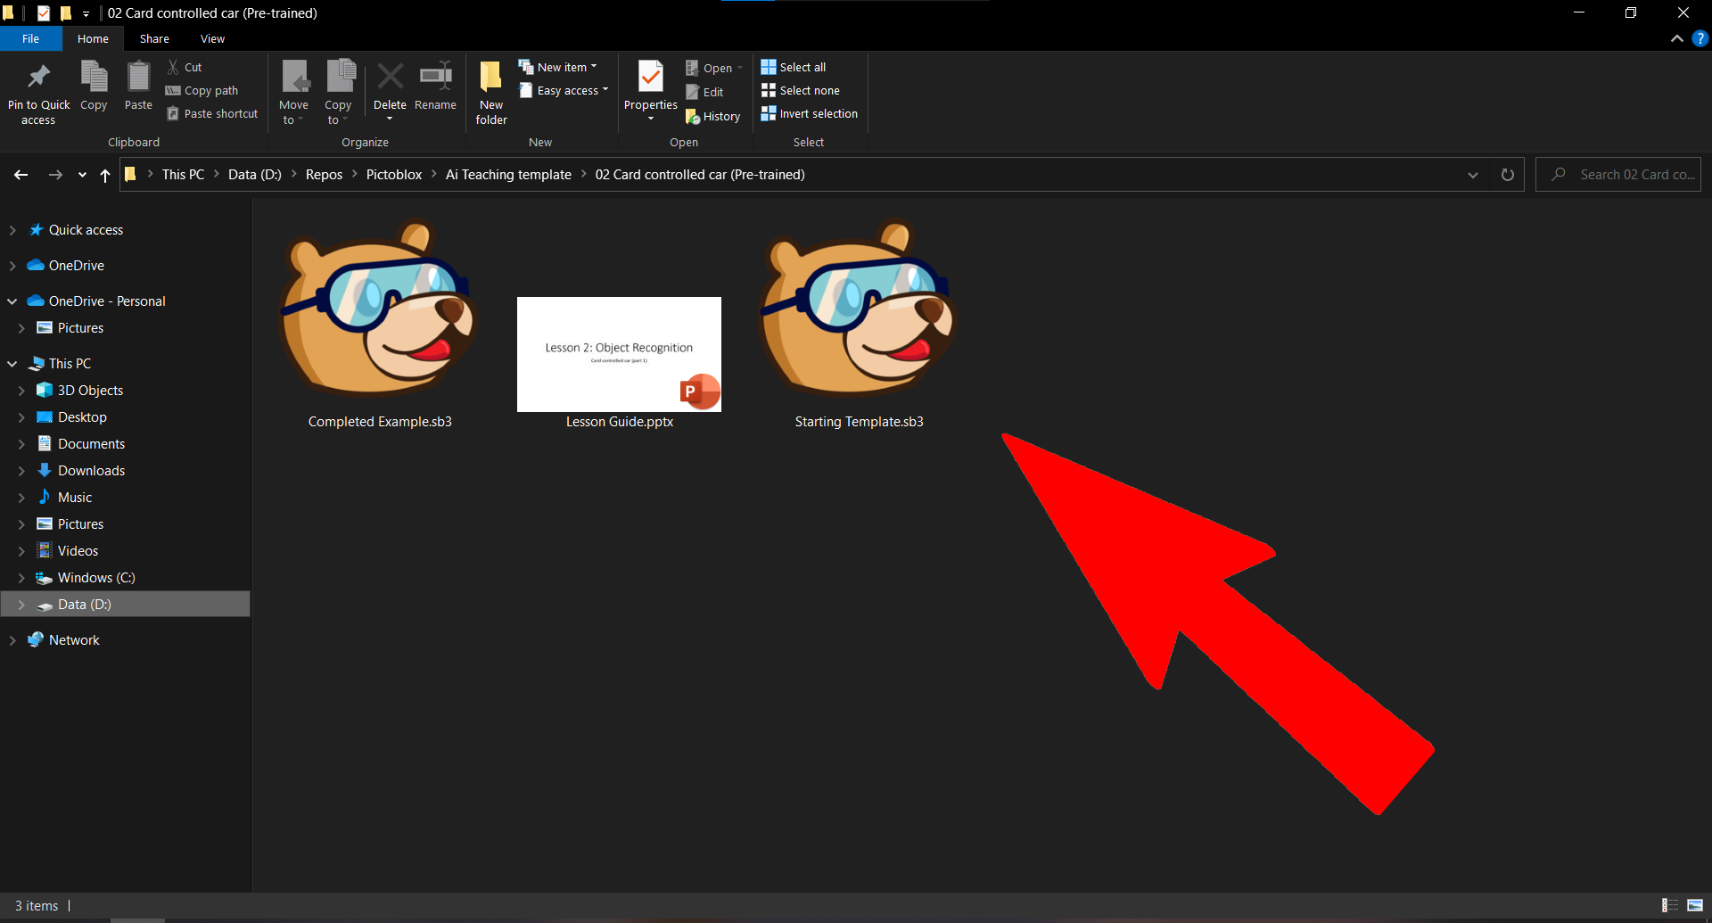
Open “Starting Template”

Slide 4
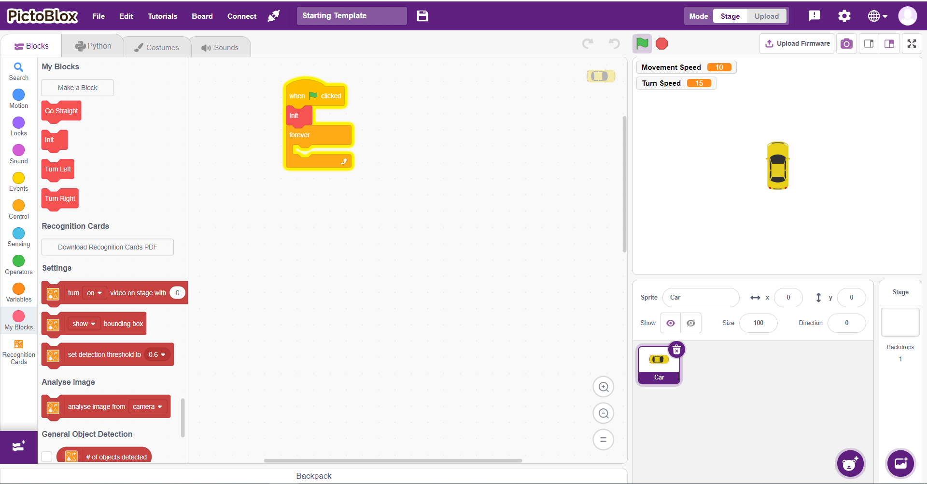
This is what you will see

Slide 5
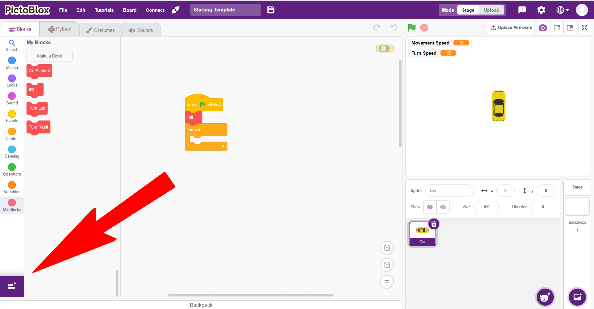
Click on the purple box to open extensions

Slide 6
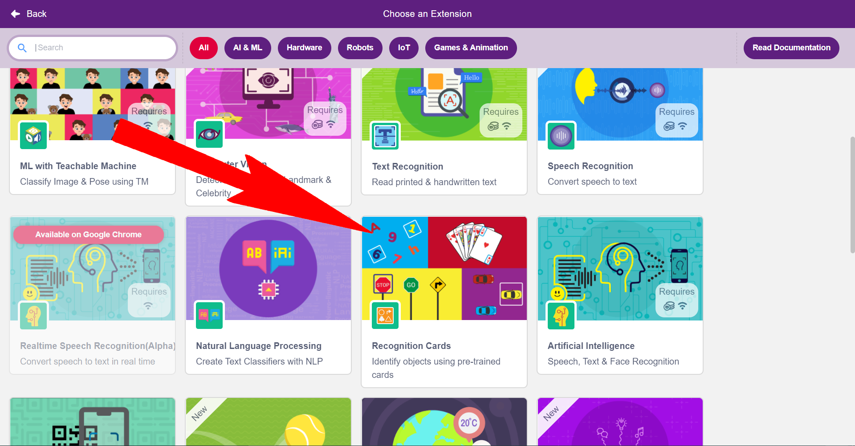
Scroll and click on “Recognize Cards”

Slide 7
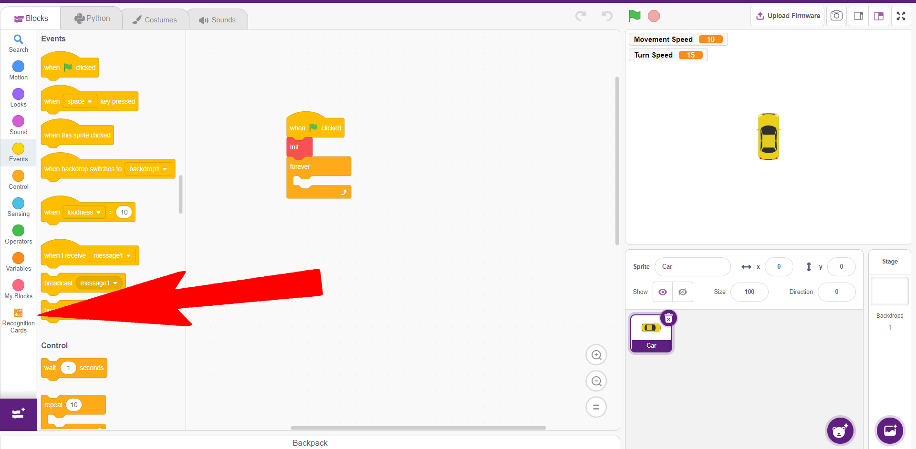
Go to “Recognition Cards”

Slide 8
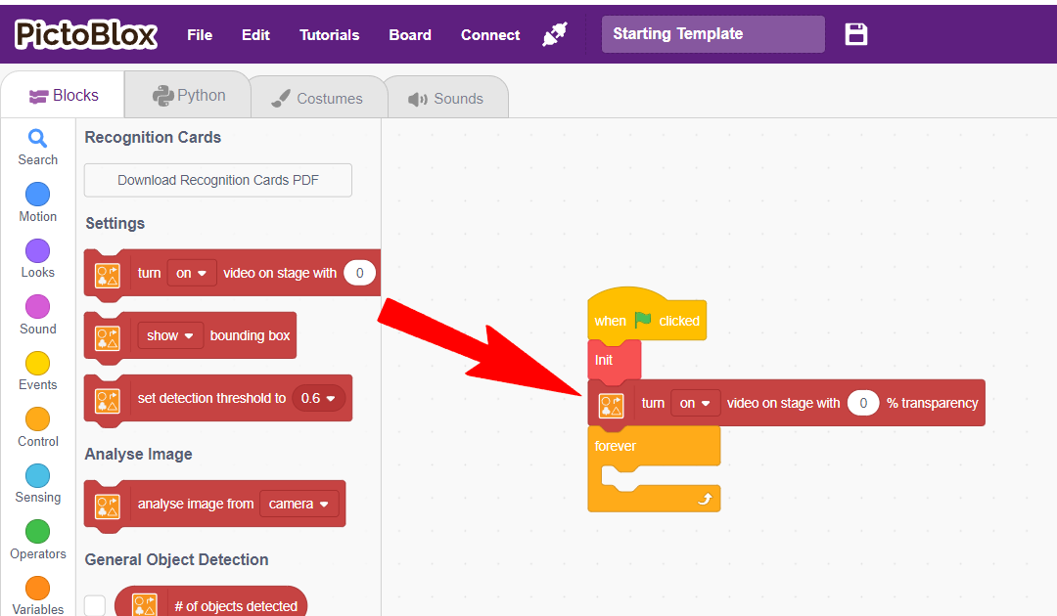
Add “Turn on video on stage with 0% transparency” between “Init” and “forever”

Slide 9
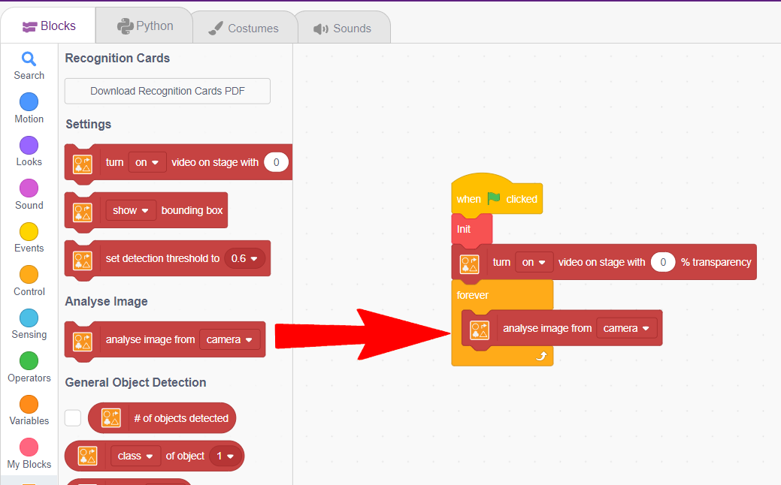
Add “analyze image from camera” into “forever”

Slide 10
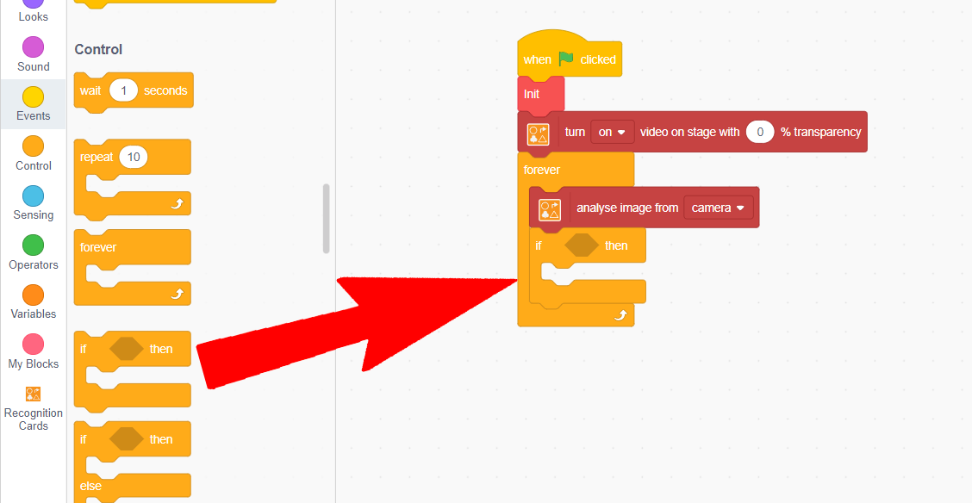
Add the “If ___ then” block

Slide 11
Add the “If ___ then” block

Slide 12
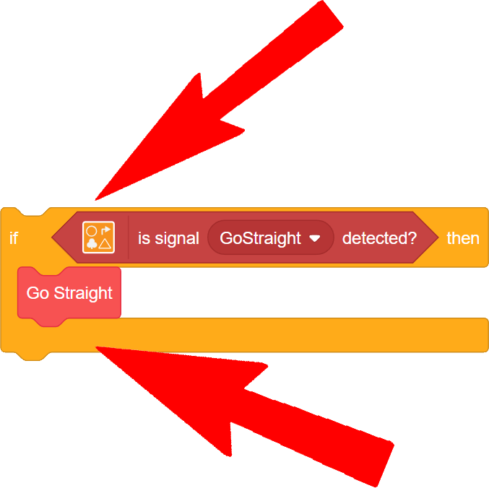
An If-Then block has 2 parts
Condition
Body
The body is only run if the condition is met

Slide 13
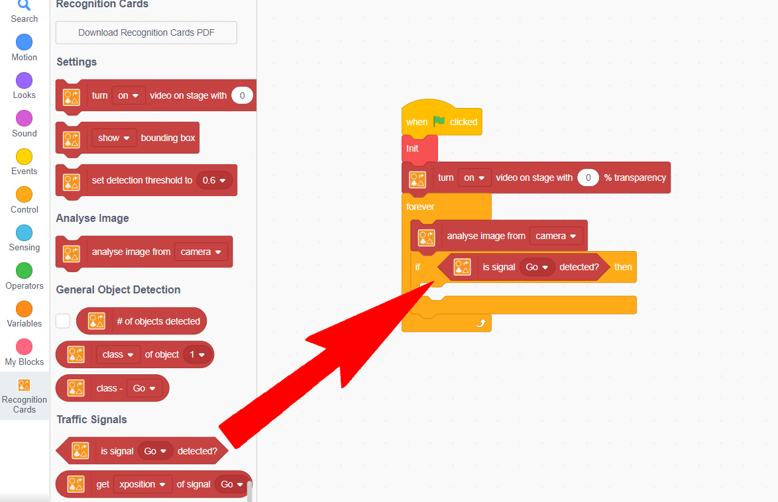
Add “Is signal Go detected?” to the condition

Slide 14
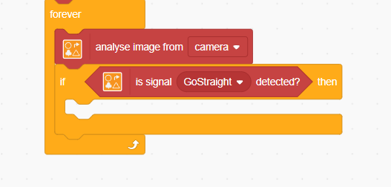
Change “Go” to “GoStraight”

Slide 15
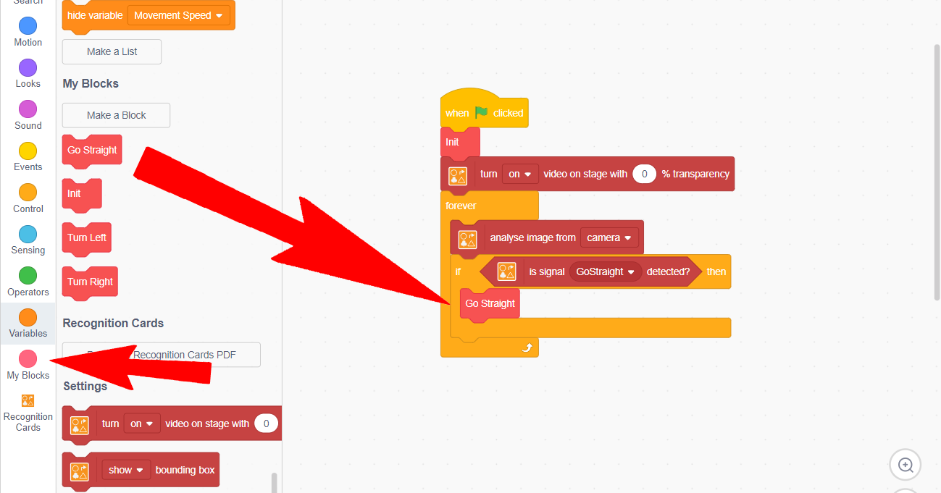
Go to “My Blocks” and add “Go Straight” to the body

Slide 16
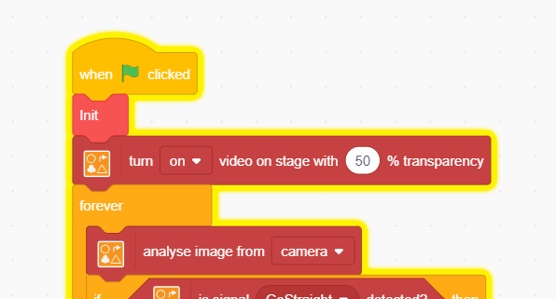
Set the transparency to 50%

Slide 17
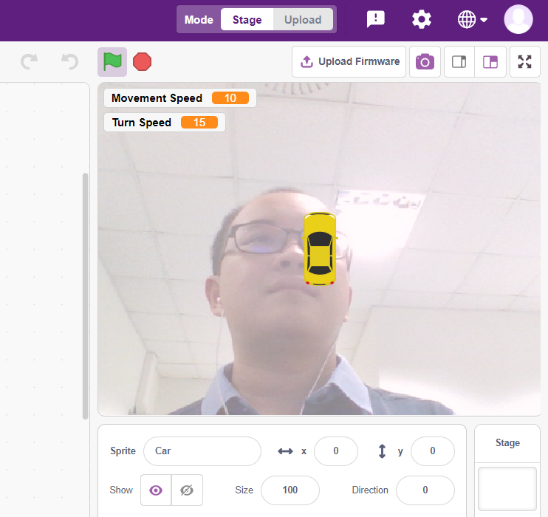
Turn on your webcam and start the program

Slide 18
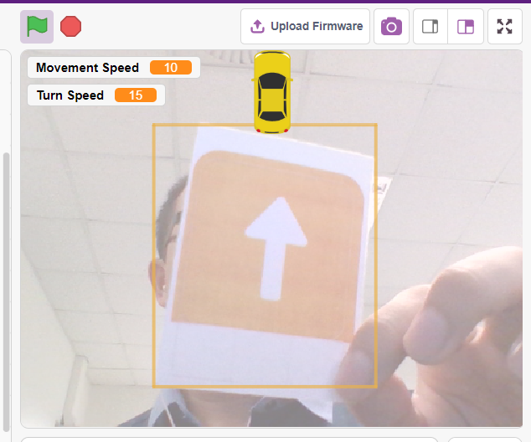
Show the yellow “GoStraight” card and the car should move forward

Slide 19
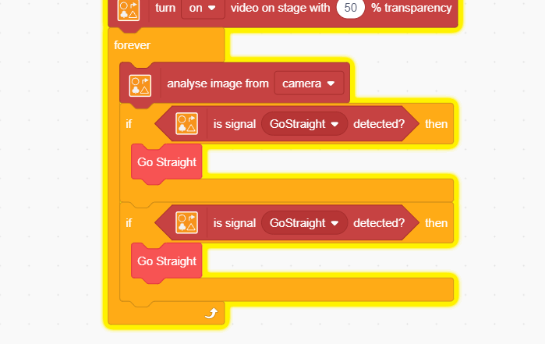
Duplicate the If-Then block
Remember that you can right-click the block and click on “duplicate”

Slide 20
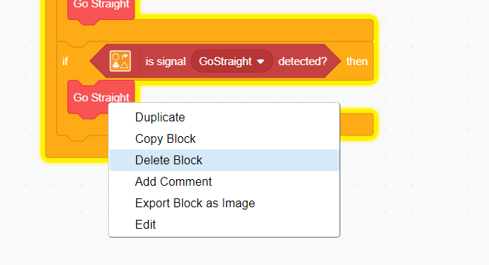
Right click on “Go Straight” delete it
You can press Ctrl-Z to undo if you deleted the wrong block

Slide 21
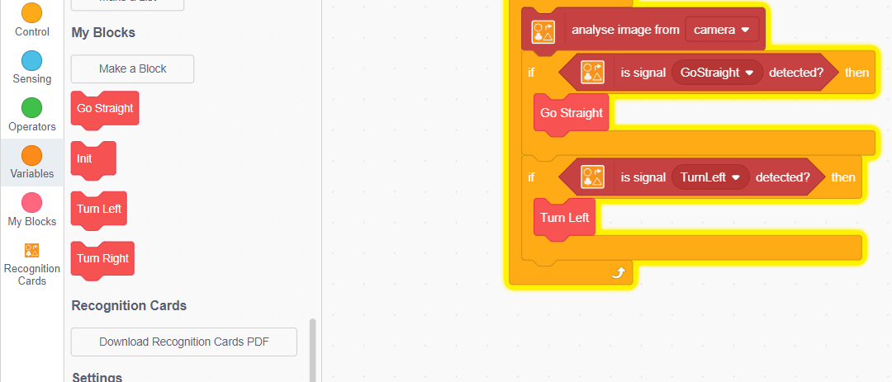

Change “GoStraight” in the Condition to “TurnLeft”

Slide 22

Add “Turn Left” from My Blocks

Slide 23
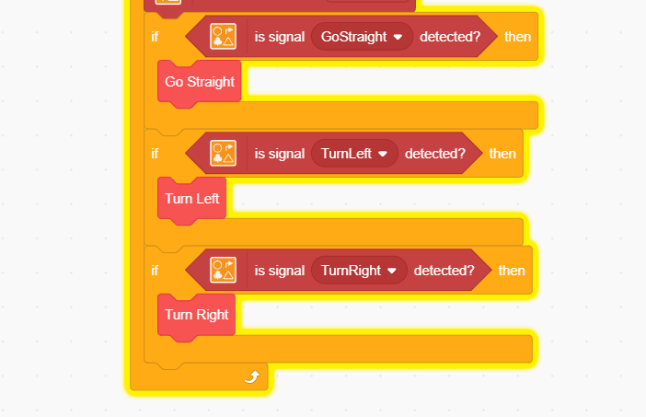
Repeat the same steps for “Turn Right”

Slide 24
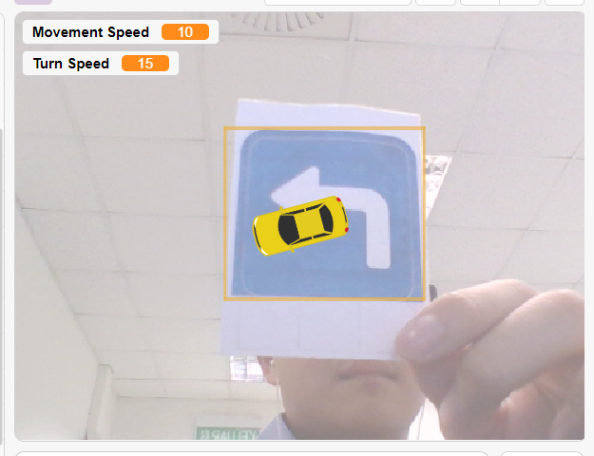
Your car should rotate when shown the blue/green card

